Slide 1
DATA 55100– Unsupervised Machine Learning
Dr. Sam Abuomar
DATA 55100– Unsupervised Machine Learning
Introduction to Clustering- Part 2 Dr. Sam Abuomar
Dept. of Engineering, Computing, and Mathematical Sciences

Slide 2

Fuzzy c-means
Objective function based clustering
SUPERIOR TO Hierarchical K-means (HKM)/Hard K-means (HCM):
Regardless of what data science community, especially the computer vision branch believes!
Tend to use the HCM as quantization versus clustering
Created by James Bezdek
I believe fuzzy clustering roots back to Raspini

Slide 3
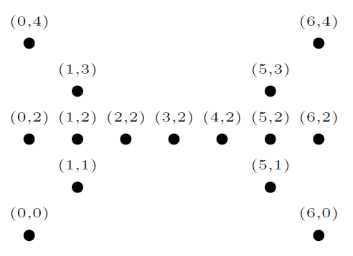
What is the membership?
Butterfly data set
What is the value? 0.5?

Slide 4
David Marr
Computer vision
Principle of least commitment
If you are doing something along the way, and using crisp assumptions, then you can’t undo it
Should always hedge your results
Don’t do something that will have to be later undone

Slide 5
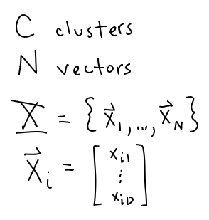
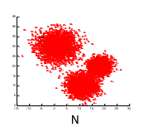
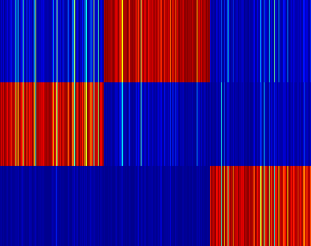
Basic notation
C
FCM

Slide 6
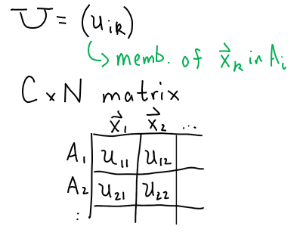
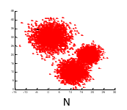
Membership matrix
C
FCM

Slide 7
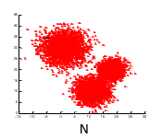
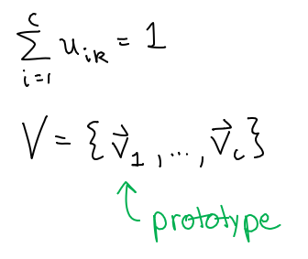
Membership matrix > U
C
FCM

Slide 8
Cost function

Slide 9
Cost function

Slide 10
Lagrange multipliers

Slide 11
Lagrange multipliers

Slide 12
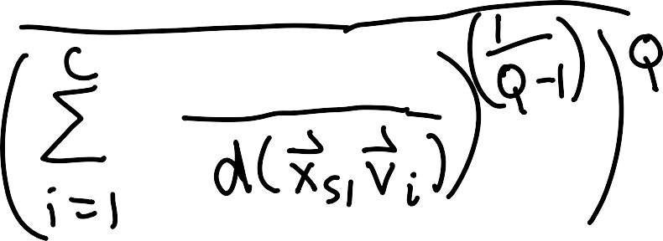
Lagrange multipliers

Slide 13
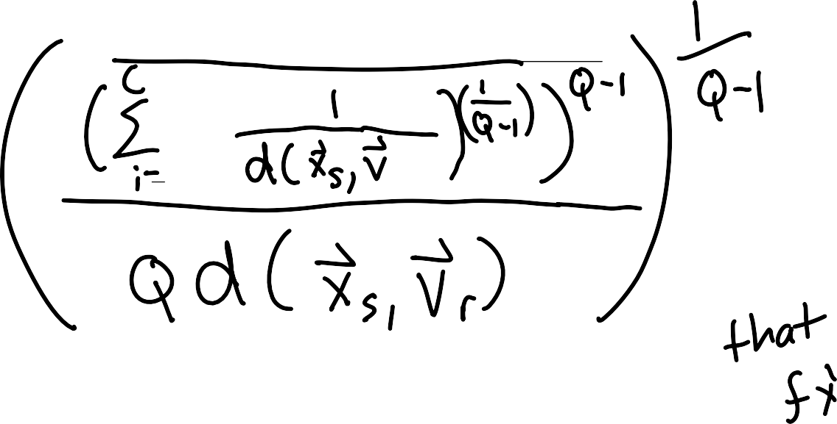
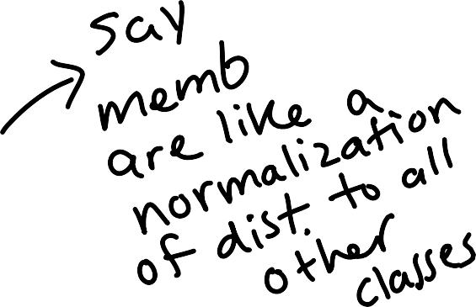
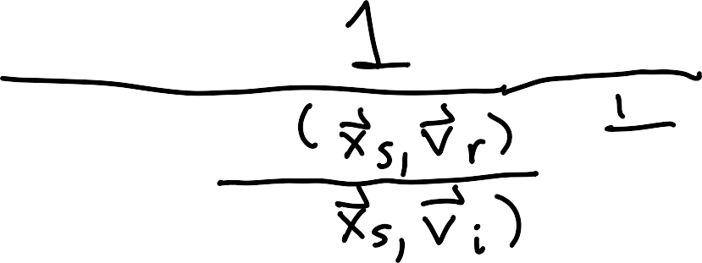
Lagrange multipliers

Slide 14
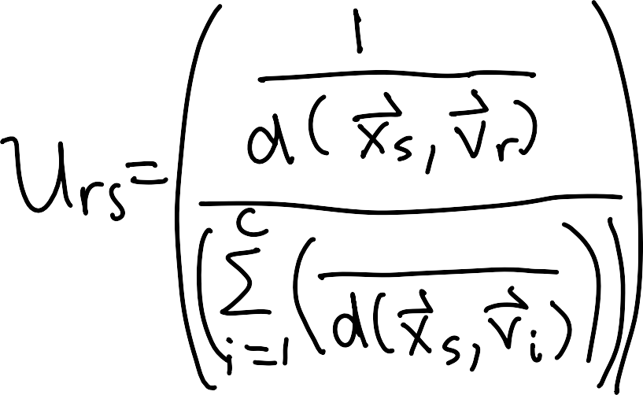
Lagrange multipliers

Slide 15
Lagrange multipliers

Slide 16
Distance measures

Slide 17
Distance measures

Slide 18
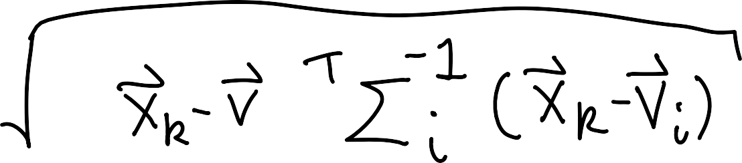
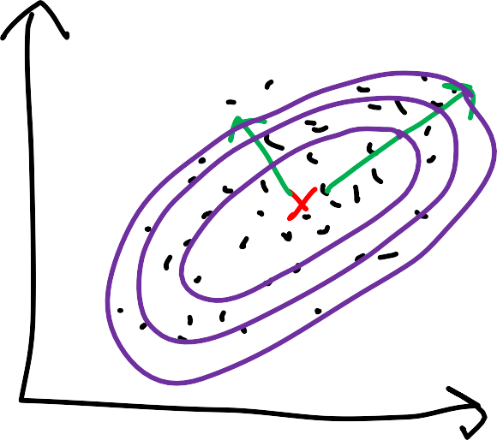
Mahalanobis distance

Slide 19
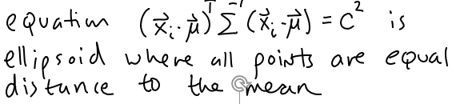
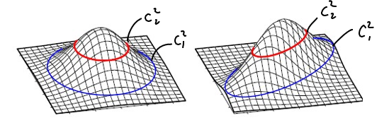
Determinate of covariance matrix

Slide 20
Covariance matrix

Slide 21
Covariance matrix

Slide 22
Covariance matrix

Slide 23
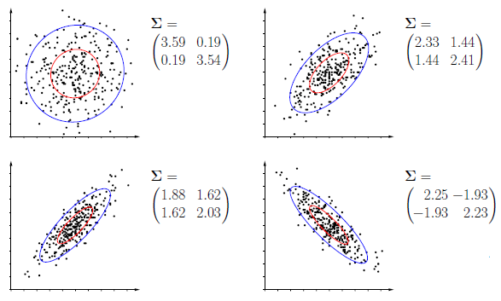
Covariance matrix

Slide 24
Gustafson-Kessel (GK) distance

Slide 25
Gustafson-Kessel (GK) distance

Slide 26

FCM algorithm
Initialization
Select 2 ≤ c ≤ (N-1)
Set q (fuzzifier), generally 2
Select initial prototypes
Random initialization
Pick furthest initial points + random
Pick exemplars (points from the data set)
Set iteration counter t = 1
Do until convergence

Slide 27
Step 1: Pre-calculate distances

Slide 28
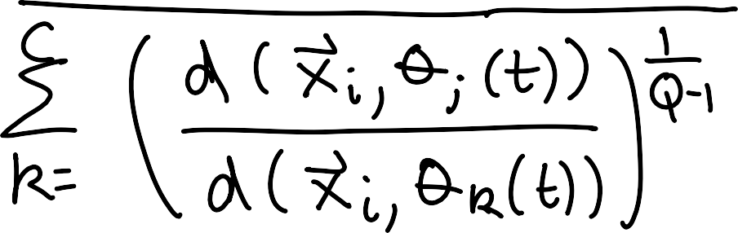
Step 2: Update membership matrix

Slide 29
Step 3: Update prototypes

Slide 30
Step 4: Test for convergence
Select termination criteria
Number of iterations
Difference from (t) to (t-1) of
Sum of prototype differences
Consider covariance matrix?
Comparing soft partitions (e.g. my research)

Slide 31
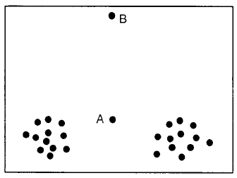
Question: What should the memb’s be???
FCM is a partitioning algorithm! It is effected by noise.

Slide 32
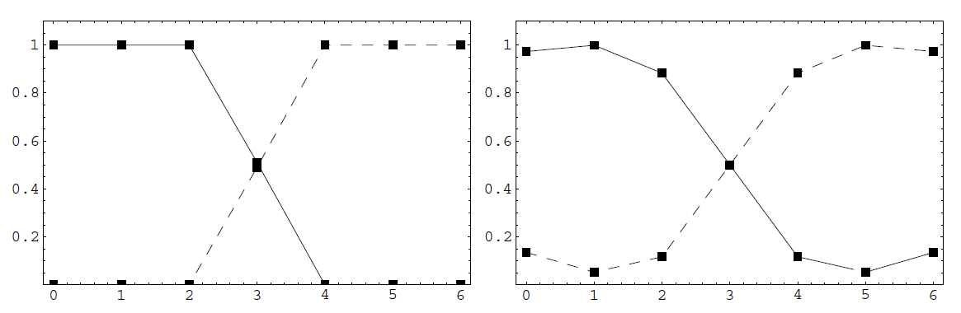
FCM and q
q=1.25
q=2

Slide 33
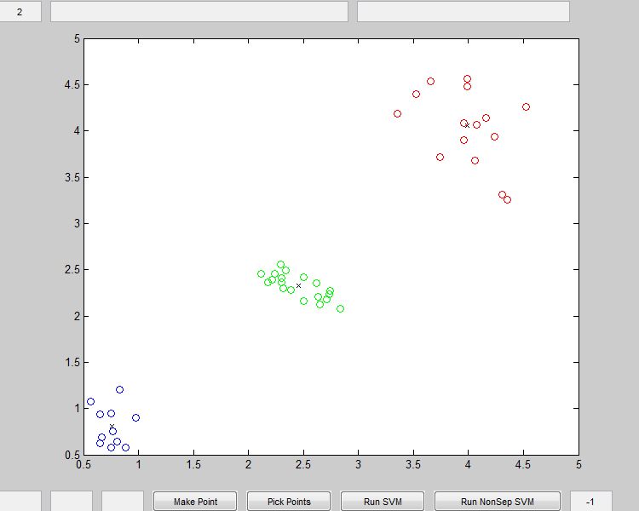
Example: FCM

Slide 34
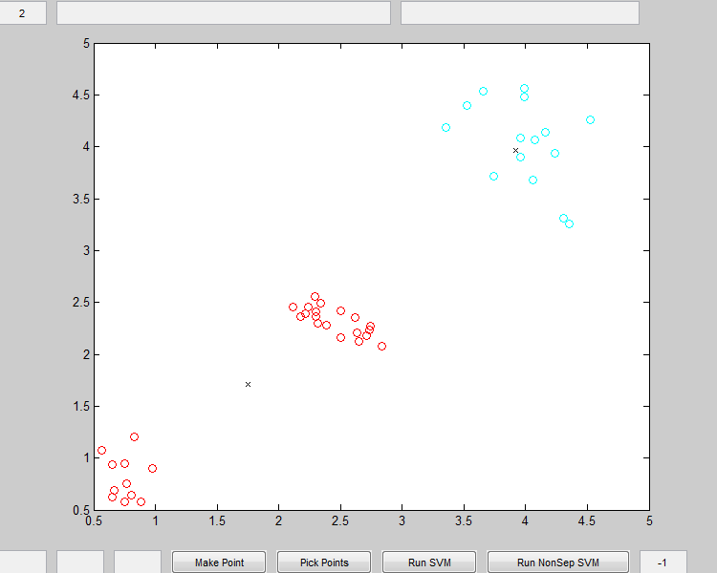
Example: FCM

Slide 35
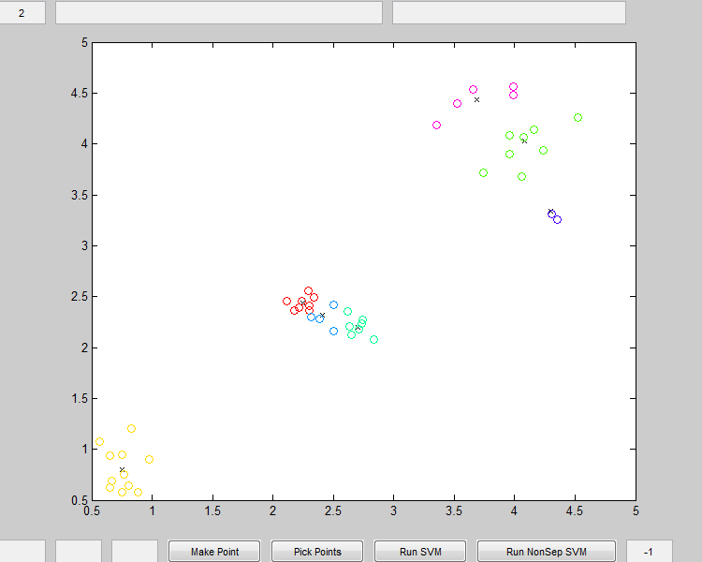
Example: FCM

Slide 36
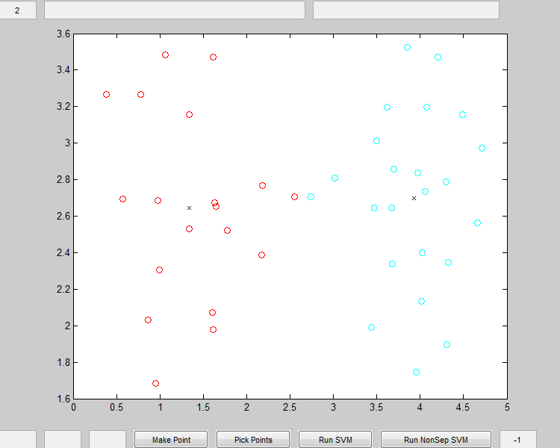
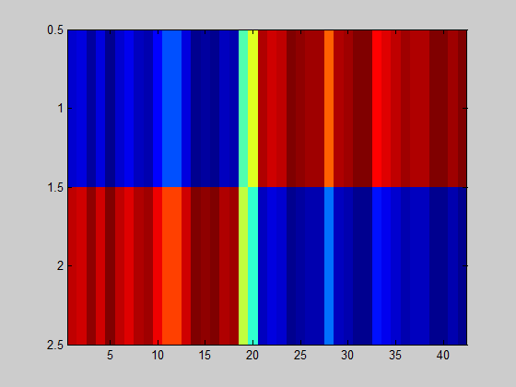
Example: FCM

Slide 37

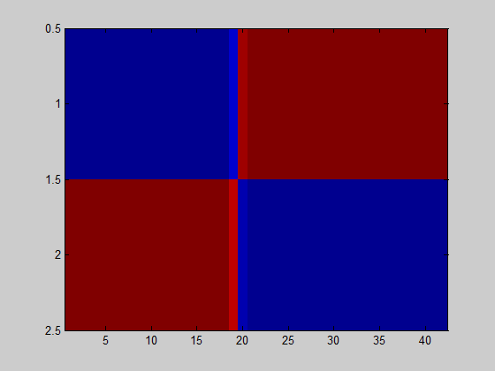
Example: FCM

Slide 38
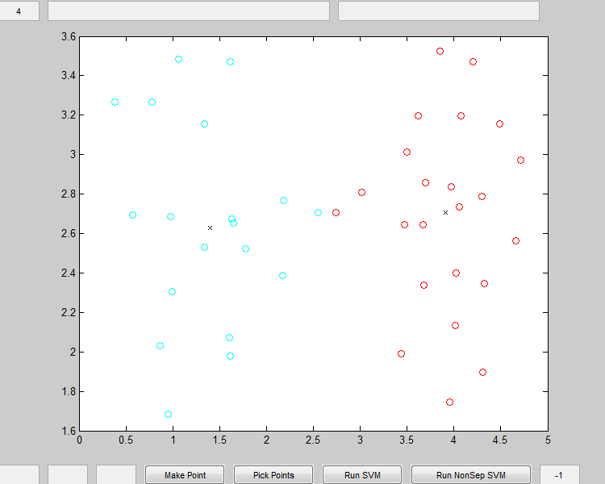
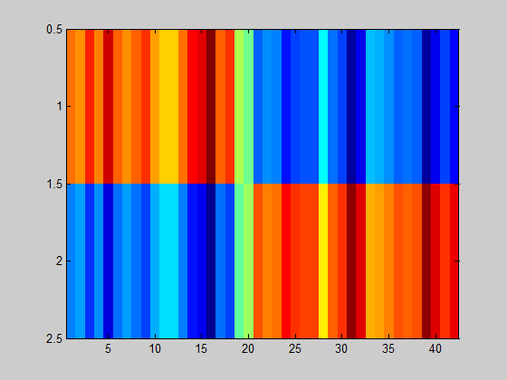
Example: FCM

Slide 39
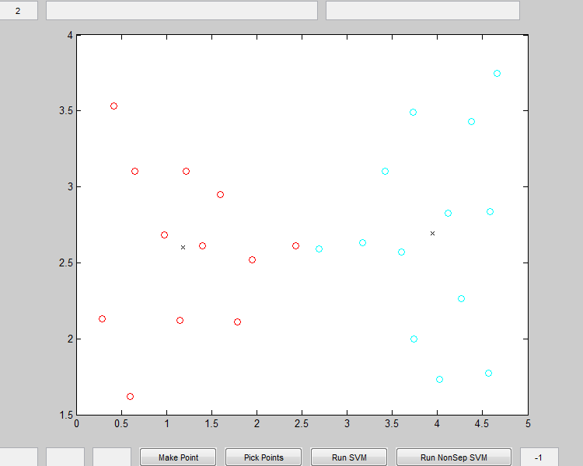

Example: FCM

Slide 40
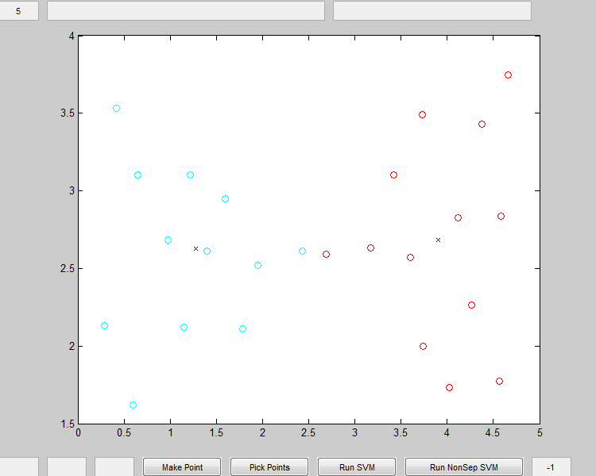

Example: FCM

Slide 41
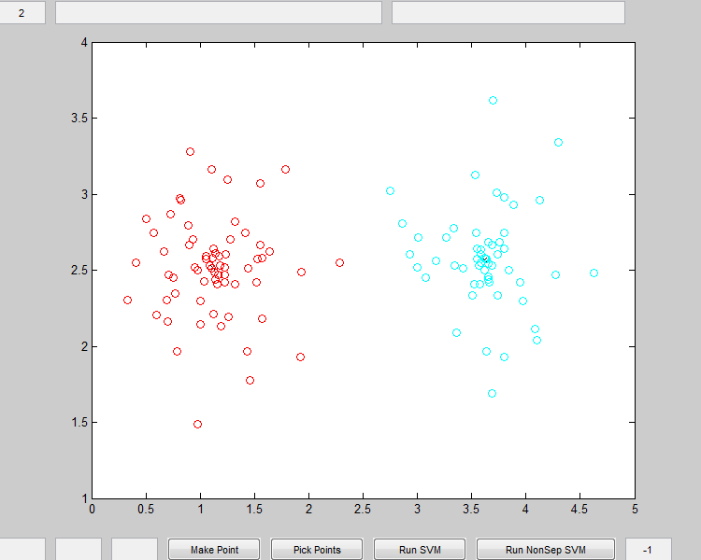

Example: FCM

Slide 42
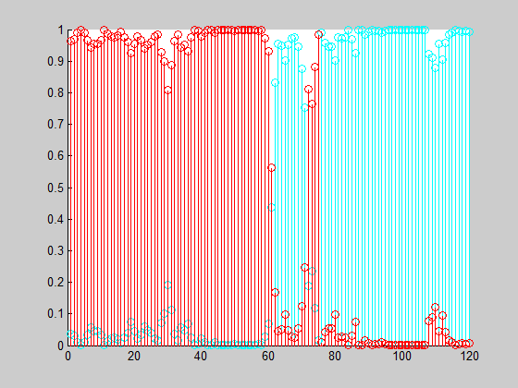
Example: FCM

Slide 43

Example: FCM

Slide 44
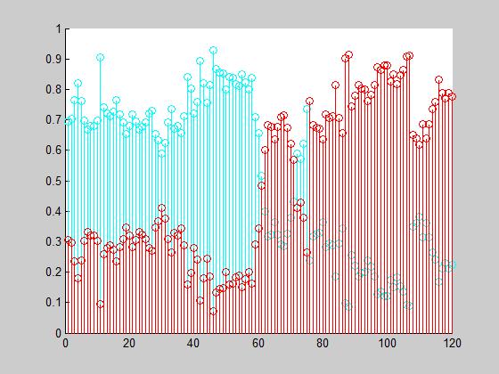
Example: FCM

Slide 45
FCM Update

Slide 46
FCM Update

Slide 47
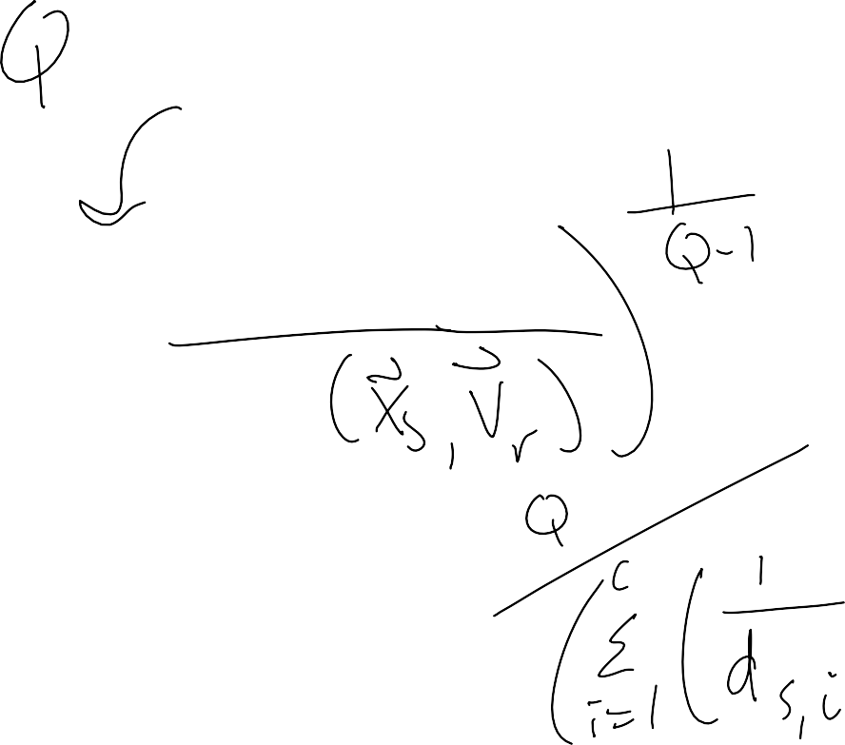
FCM Update

Slide 48
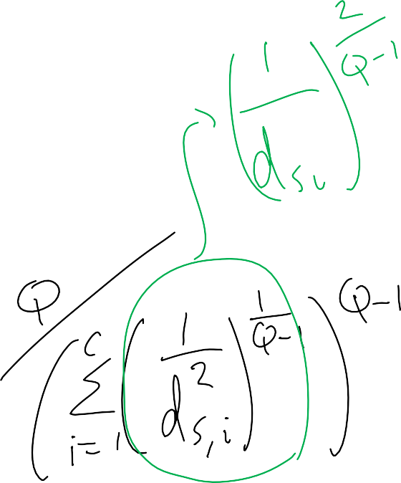
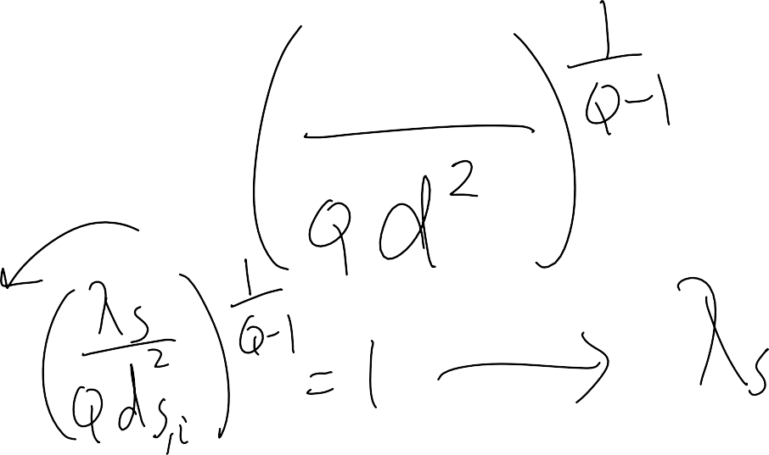
FCM Update

Slide 49
Updates

